Slide 1

Swire Coca-Cola Predicting Customer Success
Brian Burdick
Derick Lee
Kayla Smartz
Sandy White
Notes:
Hello everyone, my team and I chose the analytics project where we predicted customer sales. Before we jump into the presentation, we wanted to introduce ourselves my name is Brian Burdick.

Slide 2
Business Problem Statement
Predict profitable customers using gross profit over a three-year period
Notes:
The goal of our analysis was to predict profitable customers using gross profit over a three-year period

Slide 3
Dataset Overview
Swire Datasets
Customer
Sales
Augmented by USDA Dataset:
2013 Population by zip code
Notes:
In addition to the client data provided we augmented it with population data based on population zip code. In our final dataset used for our models we combined the trade channels, totaled sales, and aggregated on the customer level. We also used business type description, trade type description, market type description.

Slide 4
Data Preparation and Cleaning
One row for each customer
Created dummy variables for predictors
Removed incomplete observations
Dropped order information
Notes:
For our models, we created dummy variables for all categorical variables. There was a handful of observations with missing data which we also removed. One thing I noticed when reviewing the trade channel descriptions was that a lot of the information seemed redundant, which gave us concern about multicollinearity. We reduced the trade channel descriptions to a single variable for the model. Customer longevity with Swire was grouped into less than a year, 1-5 years, and more than five years. We used a 80/20 training-test split for model analysis. We also dropped highly correlated variables such as physical volume, discount, invoice price, and COGS due to them being highly correlated predictors to our target variable but would not be present in pursuing new customers.

Slide 5
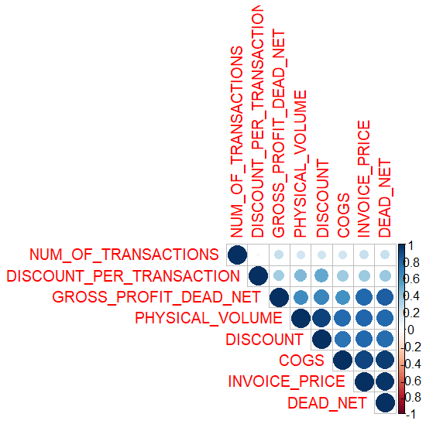
EDA – Correlation
Notes:
We also realized that many of the numeric variables in the joined data set would have high correlation to our outcome variables but would not serve as informative variables to our model.
I am going to turn it over to Sandy to talk about our models.

Slide 6
Predictor Variables
Predictors
Market Type
Business Type
Customer Trade (collapsed)
Customer Activity
Customer Tenure Grouping
Population
Outcome Variable
3 years of gross profit
Notes:
For our models, we created dummy variables for all categorical variables. There was a handful of observations with missing data which we also removed. One thing I noticed when reviewing the trade channel descriptions was that a lot of the information seemed redundant, which gave us concern about multicollinearity. We reduced the trade channel descriptions to a single variable for the model. Customer longevity with Swire was grouped into less than a year, 1-5 years, and more than five years. We used a 80/20 training-test split for model analysis. We also dropped highly correlated variables such as physical volume, discount, invoice price, and COGS due to them being highly correlated predictors to our target variable but would not be present in pursuing new customers.

Slide 7
EDA Results
Distribution and percentage of categorical variables
Average volume and discount
Best-selling products
Visualized scatter plots of numeric variables
Notes:
The first model we tried was XG Boost, which used a classification tree design. We initially used the three-year profit variable as a continuous outcome and ran XG Boost using a regression fit. This model performed very poorly, so we then used a classification method instead, grouping profit based on the 25th, 50th, and 75th percentiles. This vastly improved model performance.

Slide 8
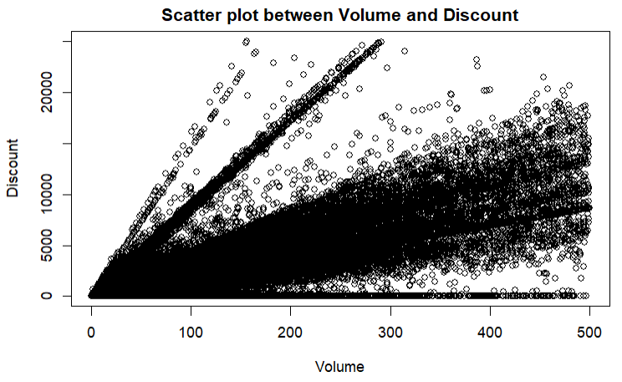
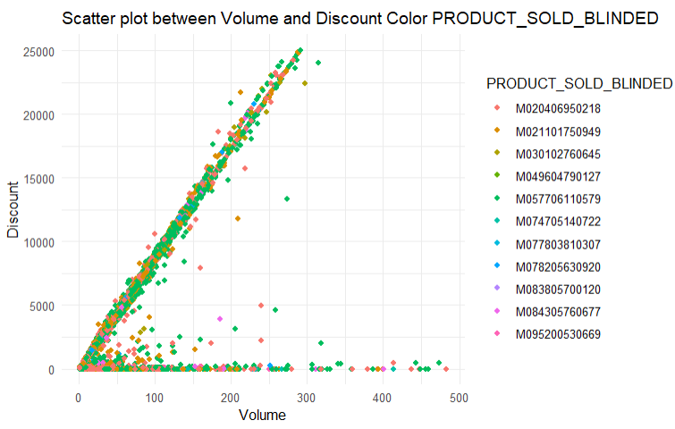
EDA Results
Core Sparkling, 5 Gallon with blinded product name of M057706110579.
Notes:
While we were developing scatter plots, we identified an interesting pattern between volume and discount. Generally, this relationship stayed within a certain band. However, there was a pattern where high discounts were given for lower quantities. We decided to drill in further and found that this pattern was mostly associated by this one product which was core sparkling product.

Slide 9
Models Considered
Support Vector Machine
XG Boost
Neural Net
Linear Regression
Notes:
The first model we tried was XG Boost, which used a classification tree design. We initially used the three-year profit variable as a continuous outcome and ran XG Boost using a regression fit. This model performed very poorly, so we then used a classification method instead, grouping profit based on the 25th, 50th, and 75th percentiles. This vastly improved model performance.

Slide 10
Models Selected
XGBoost
Considered the industry standard for machine learning model
Linear Regression
Easily interpretable
Notes:
To summarize, for our final models, we used the customer trade grouping, customer longevity with Swire in groups, population from the USDA, market and business type descriptions as predictors

Slide 11
XGBoost Model

Slide 12
Methods
Created test and training datasets using 80/20 split
Outcome variable three-year profit using regression performed poorly so used classification method instead
Quartile outcome variable using three-yr profit
Used 25th, 50th, and 75th percentiles for grouping
Notes:
The first model we tried was XG Boost, which used a classification tree design. We initially used the three-year profit variable as a continuous outcome and ran XG Boost using a regression fit. This model performed very poorly, so we then used a classification method instead, grouping profit based on the 25th, 50th, and 75th percentiles. This vastly improved model performance.

Slide 13
XGBoost Model
Hyperparameter grid search to find best model
Five-fold cross-validation performed
Best model:
Number of trees: 667
Tree depth: 5
Learning rate: 0.1
Notes:
To summarize, for our final models, we used the customer trade grouping, customer longevity with Swire in groups, population from the USDA, market and business type descriptions as predictors

Slide 14
XGBoost Results
ROC AUC: 0.74
Accuracy: 0.48
Notes:
To summarize, for our final models, we used the customer trade grouping, customer longevity with Swire in groups, population from the USDA, market and business type descriptions as predictors

Slide 15
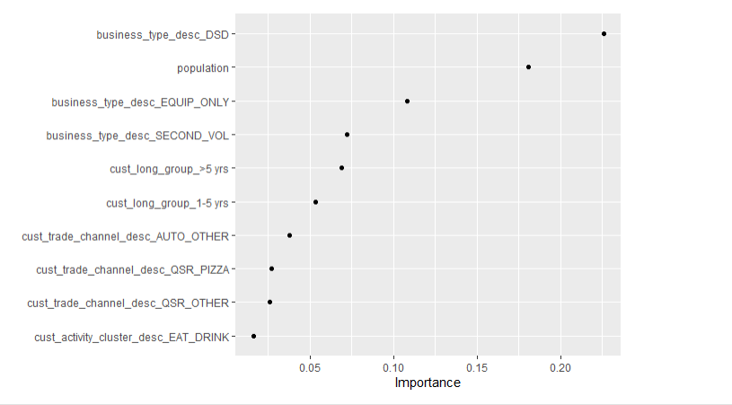
XGBoost: Most Influential Predictors
Notes:
Here is a graph which showed the most important predictors in the XG Boost Model. A business type of direct-sales distribution was the most influential, followed by population and customers that used only equipment.

Slide 16
XGBoost Model Evaluation
Strengths:
High AUC
Multicollinearity not an issue for this type of model
Limitations:
Extremely time intensive! Over one day to run model on the complete dataset, even with using parallel processing
Difficult to interpret relationship between predictors and outcome
Accuracy was low
Notes:
To summarize, for our final models, we used the customer trade grouping, customer longevity with Swire in groups, population from the USDA, market and business type descriptions as predictors

Slide 17
Linear Regression Model

Slide 18
Methods
80/20 test training split
Predictor variables are the same as XG Boost
Untransformed three-year profit variable did not meet assumptions of linear regression
Used log-transformed three-year profit for the model instead due to screw
Notes:
To summarize, for our final models, we used the customer trade grouping, customer longevity with Swire in groups, population from the USDA, market and business type descriptions as predictors

Slide 19
Linear Regression Results
Adjusted R2 results: 0.67
Residuals normally distributed, indicating an appropriate model
Notes:
To summarize, for our final models, we used the customer trade grouping, customer longevity with Swire in groups, population from the USDA, market and business type descriptions as predictors

Slide 20
Linear Regression Model
Highly significant positive predictors:
Predictor | Coefficient Estimate | P-Value
Local Dr. Pepper agency | 4.11 | p<0.001
Grocery Supermarket | 2.34 | p<0.001
Quick Service
Asian | 0.92 | p<0.001
Mexican | 0.70 | p<0.001
Hamburger | 0.41 | 0.008
Entertainment/Recreation | 0.92 | 0.001
Automotive | 0.65 | p<0.001
Notes:
Here are the associated positive predictors

Slide 21
Linear Regression Model
Highly significant negative predictors:
Predictor | Coefficient Estimate | P-value
Business type: Contract/Bid | -2.49 | p<0.001
Amusement–Theme parks | -1.03 | p<0.001
Shopping | -0.94 | p<0.001
Amusement – Other | -0.92 | p<0.001
Industrial/Agricultural | -0.84 | 0.007
Chicken fast-food restaurant | -0.47 | 0.014
Notes:
Here are the associated negative predictors

Slide 22
Linear Regression Model Evaluation
Strengths:
Model ran extremely quickly
Easy to identify relationship between predictors and outcome
Limitations:
May not have fully addressed multicollinearity
Large number of predictors may result in some being significant by chance alone
Notes:
To summarize, for our final models, we used the customer trade grouping, customer longevity with Swire in groups, population from the USDA, market and business type descriptions as predictors

Slide 23
Comparing the two models
Model considerations | XGBoost | Linear Regression
Model fit | AUC: 0.74 | R2: 0.67
Time | Intensive | Minimal
Interpretability | More difficult | Easier
Outcome variable | Categorical | Continuous
Influential predictors | Business type–DSD Population Business type–Equipment only Business type–Secondary volume | Local Dr. Pepper agency Grocery Supermarket Quick Service (Asian, Mex) Entertainment/Recreation
Notes:
Although our two models are not direct comparisons, we can compare a few aspects.

Slide 24
Model Deployment
Recommend linear regression for model deployment:
Less time intensive
Easier to interpret
Does not require categorization of outcome variable
How will it work with a new customer:
Obtain key variables from model
Run outcome
Construct three pricing options off model
Present acceptable business options
Notes:
To summarize, for our final models, we used the customer trade grouping, customer longevity with Swire in groups, population from the USDA, market and business type descriptions as predictors

Slide 25
Project Limitations
Applicability to onboarding new customers
Longer time as Coca-Cola customer indicates better sales performance.
New customers may not provide past financials or needed data.
Start up customers do not have financials/data.

Slide 26
Dataset Recommendations
Provide customer reviews
Restaurant type density
Total years in business of customer
Customer churn vs business failure
Physical location description
Hours of operation, drive thru, seating capacity, franchise

Slide 27
Business Recommendations
Create a standard pricing model
Implement different pricing offers at different phases of time
RFID tags/GPS bricks on all new customers, remove after X time

Slide 28
Summary
1. Recommend use Linear Model
2. Standardize Pricing For Each Product
3. Additional variables could be added to the dataset to improve performance
Notes:
Need to understand what data points can be determined for new customers
Linear model is recommended based of the XG Boost vs Linear Model, however there are still other models that can be explored.
In Linear Model, explore other data points. Is able to help support an outcome for a customer if able to get the data from a customer.
Need to build a standardized acceptable pricing strategy for each product

Slide 29

Questions?

